Slide 1
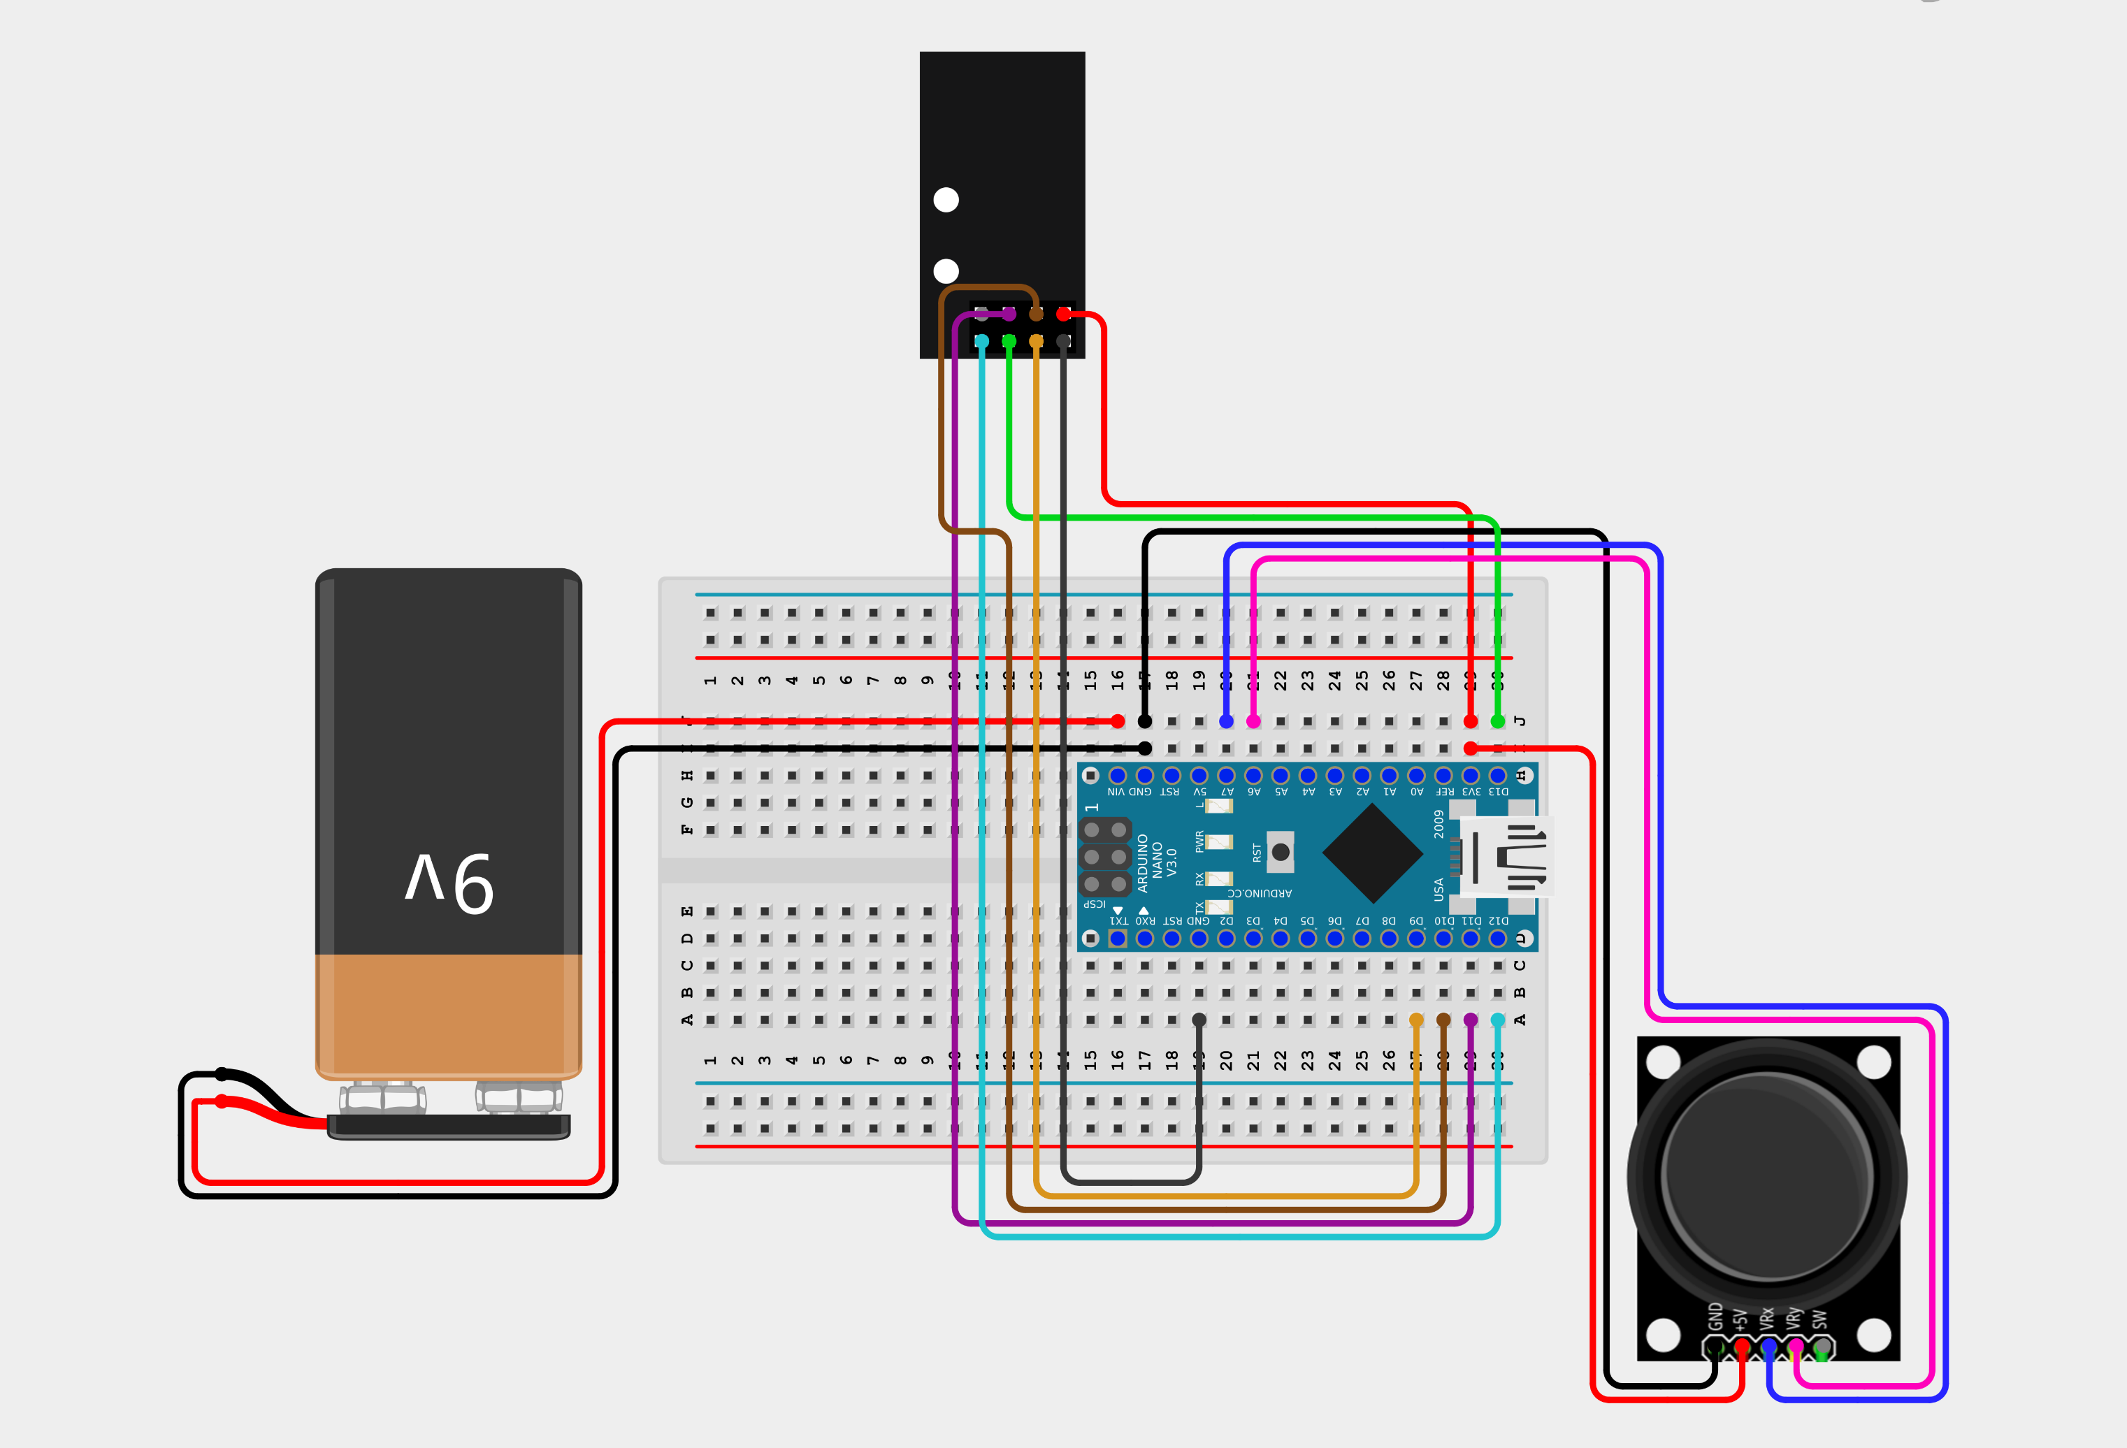
Radio Transmitter Wiring Diagram
NRF24L01 Transceiver
9V Battery
Arduino Nano
Thumbstick

Slide 2
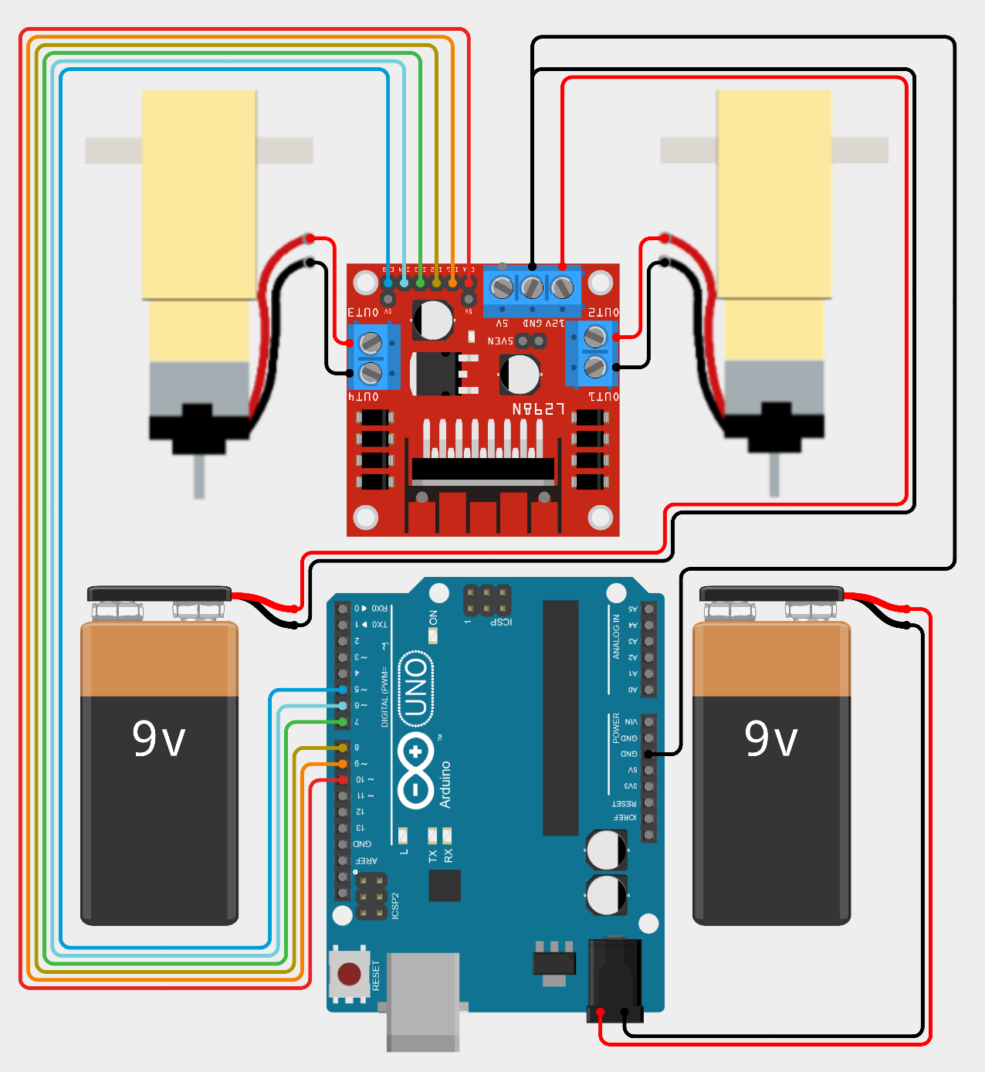
Car Wiring Diagram
L298N Motor Driver
Motor Left
Motor Right
Splice
Motor Battery (Connector with Exposed Wires)
Motor Battery (Connector with DC Jack)
Arduino Uno

